Slide 1
SQL CHALLENGE 3
CUSTOMER INSIGHTS

Slide 2
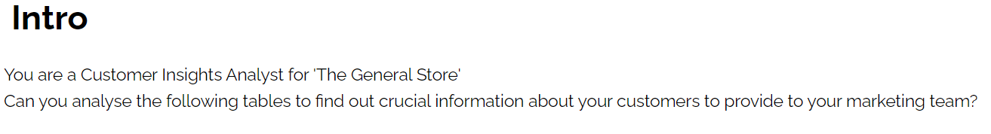

Slide 3
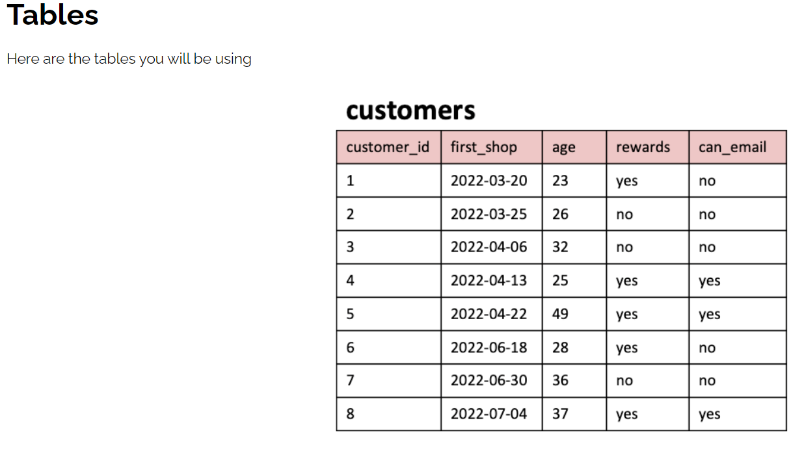
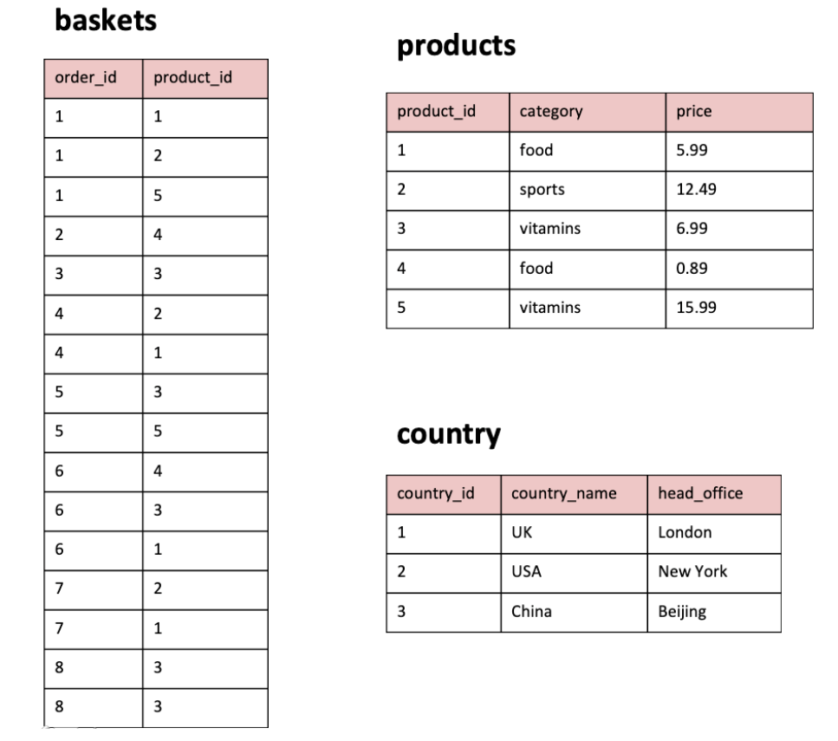
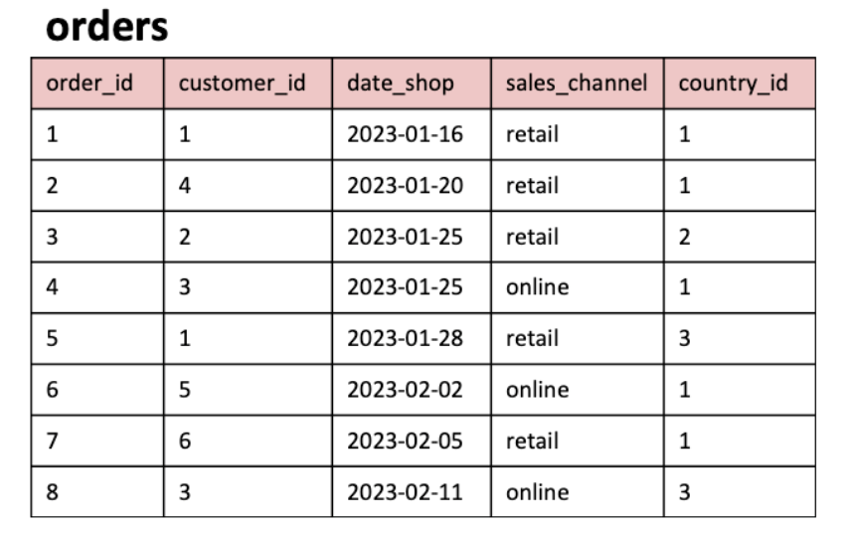

Slide 4
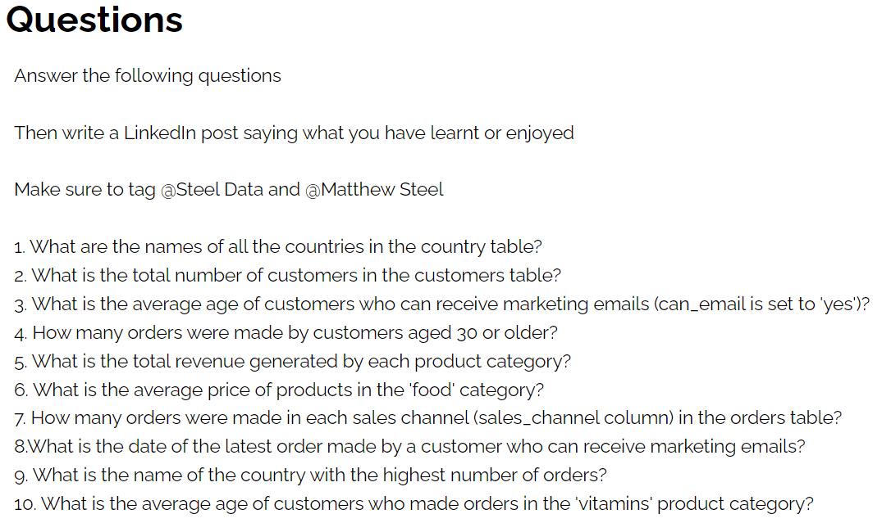

Slide 5
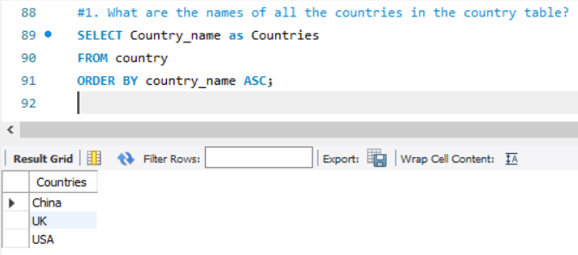

Slide 6
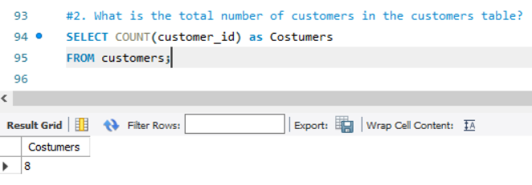

Slide 7
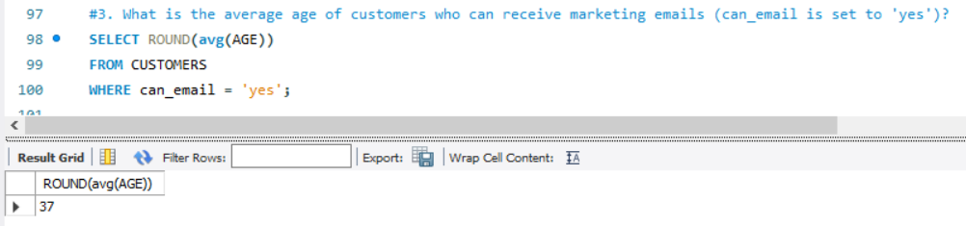

Slide 8
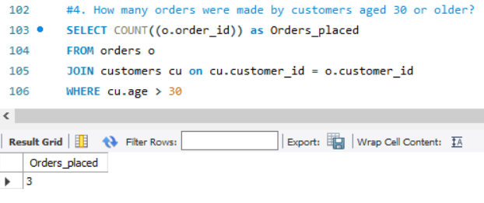

Slide 9
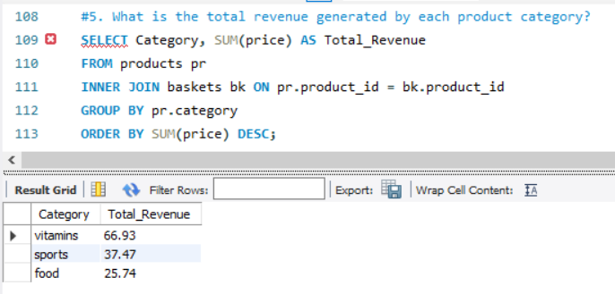

Slide 10
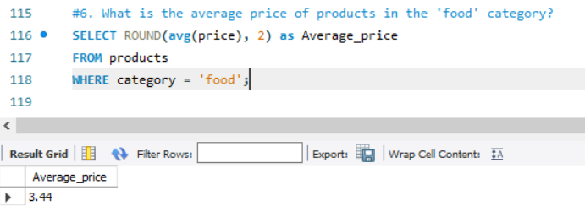

Slide 11
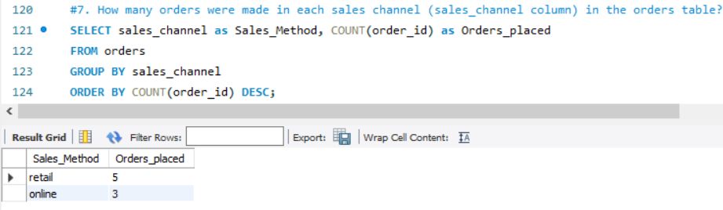

Slide 12
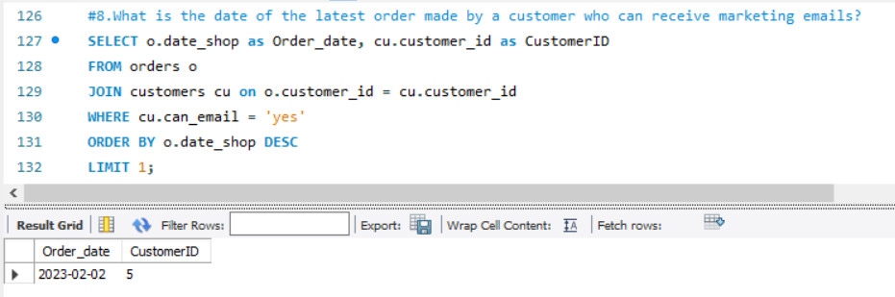

Slide 13
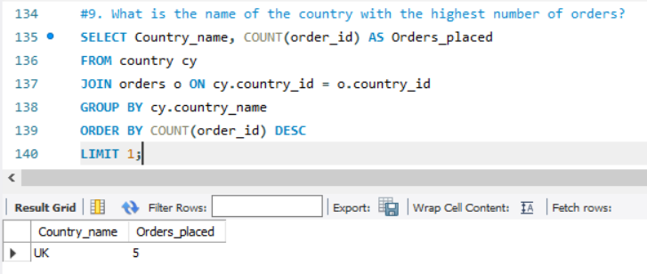

Slide 14
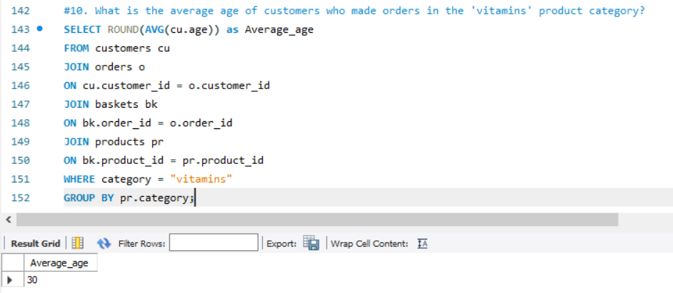

Slide 15
INSIGHTS
Three countries and 8 customers comprised of the customers research insights.
Vitamins was the food category which generated the highest revenue.
Two sale channels were analyzed where retail was where most orders were placed.
Out of 3 countries, UK was the nation with the highest orders placement.
The average age of customer who can receive marketing E-mail is 37.

